Slide 1

Sanjay Bhokare Group of Institute,Miraj AMBABAI TALIM SANSTHA’S
Department of Electronics and Telecommunication Project on:
Intelligent Traffic Signal

Slide 2
Team Introduction
Adaptive, Intelligent and Internet driven!!
Group no:3
Bhushan Hippargi
Rugved Joshi
Umar Nadaf
Group no 5:
Abhishek Bhore
Prathmesh Ainapure
Prashant Chavan

Slide 3
Introduction
This projects aims at the Introduction to the use of the Raspberry Pi 3B+ , Microcontroller AT89C52 in Traffic Signal System. It contains the flow of signals according to traffic flow using Pi camera as well as IR sensors. We also used RFID modules for the ambulance detection. Main concern of this project is to detect the heavy flow of traffic and adjust the signals accordingly to help the minimize the build up traffic. We used Python coding language to detect objects and proceed accordingly to minimize the traffic.

Slide 4
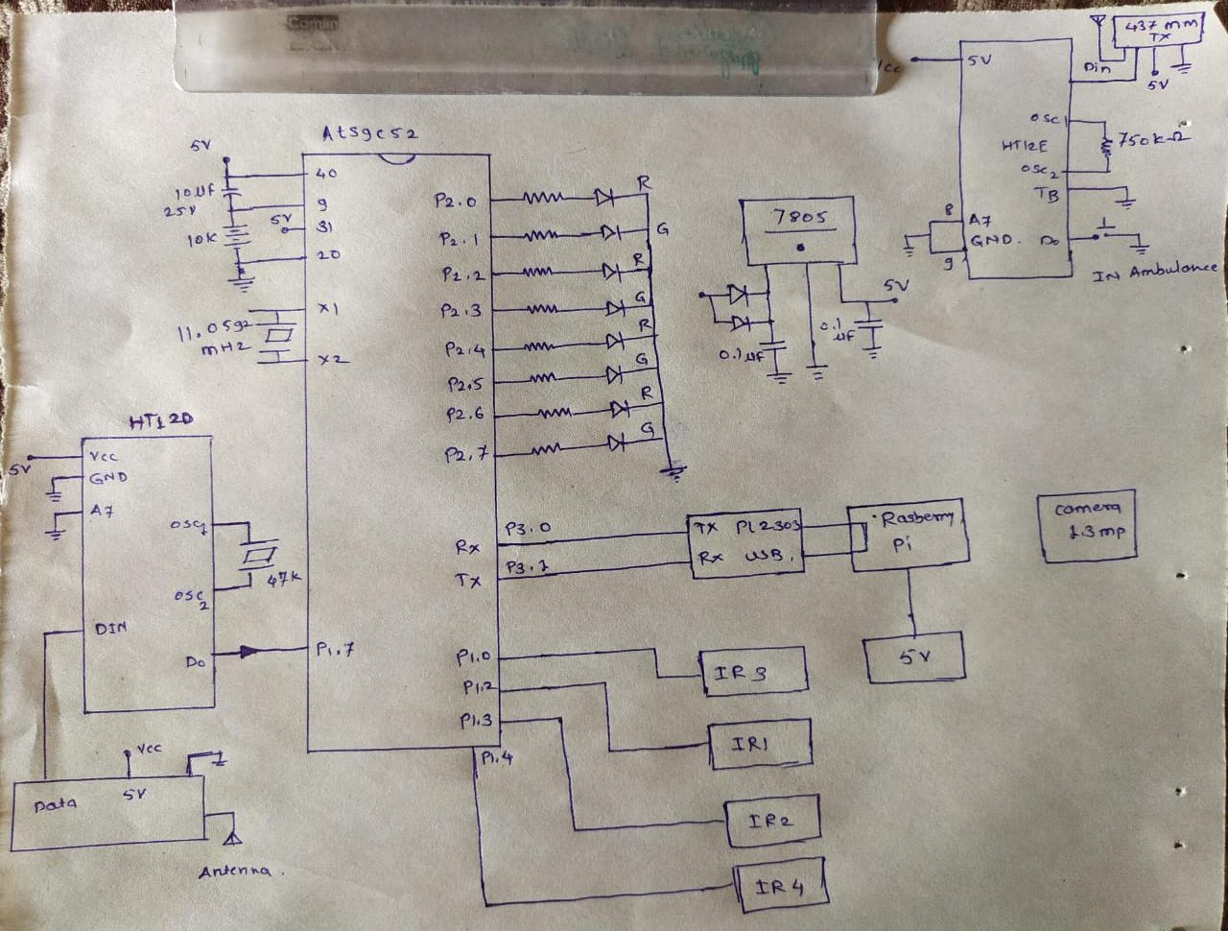
Block Diagram

Slide 5
Methods Used
Object Detection Method.
Signal Changing Terminology.

Slide 6
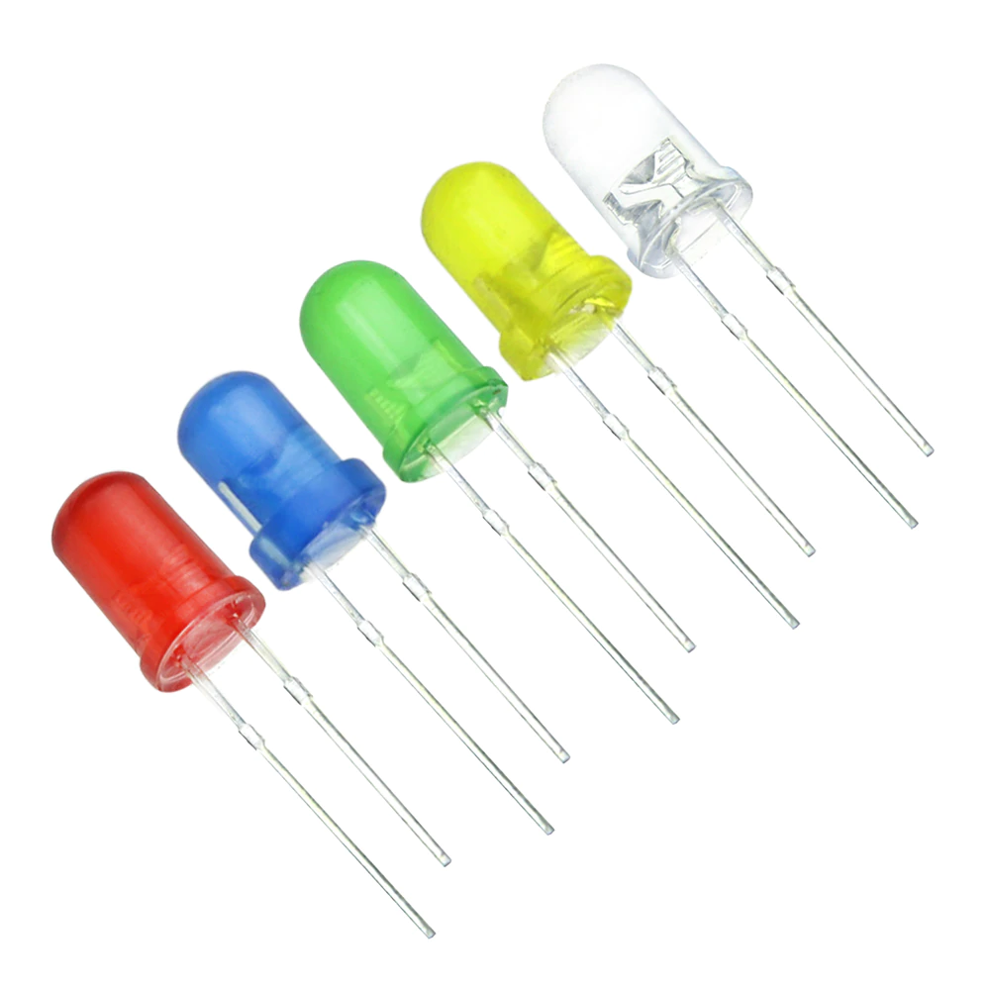
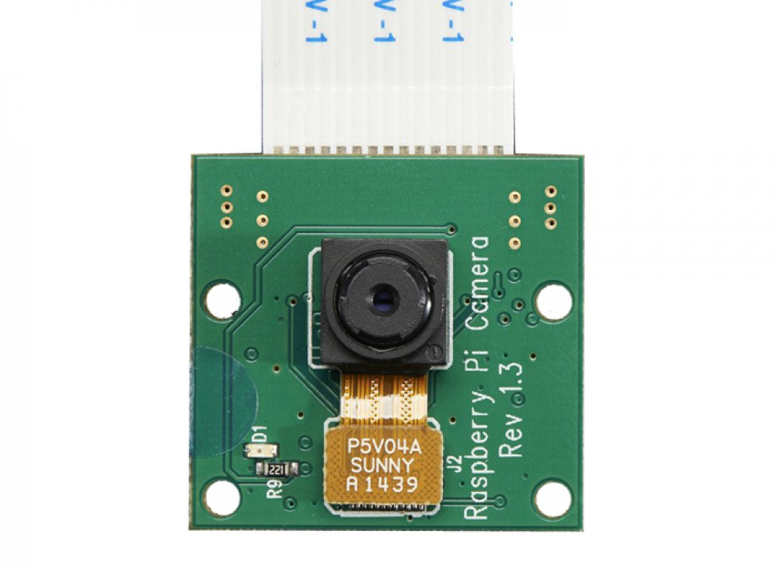
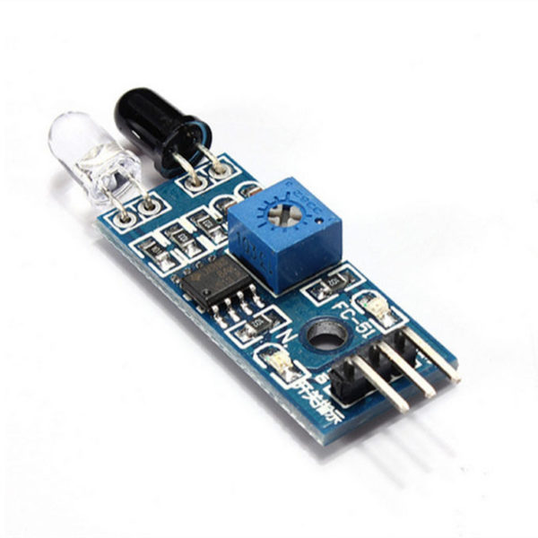
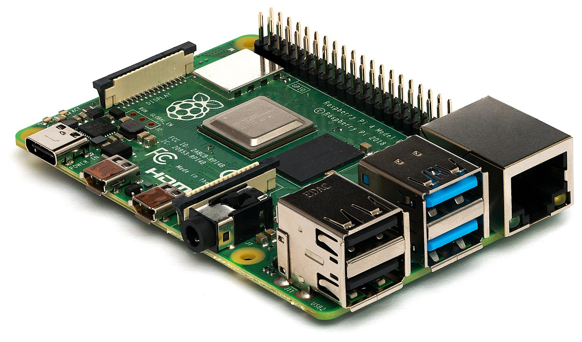
Component Used:
Raspberry Pi.
Pi Camera.
LED.
Sensor.
Microcontroller.
RF Transmitter.
RF Receiver.

Slide 7
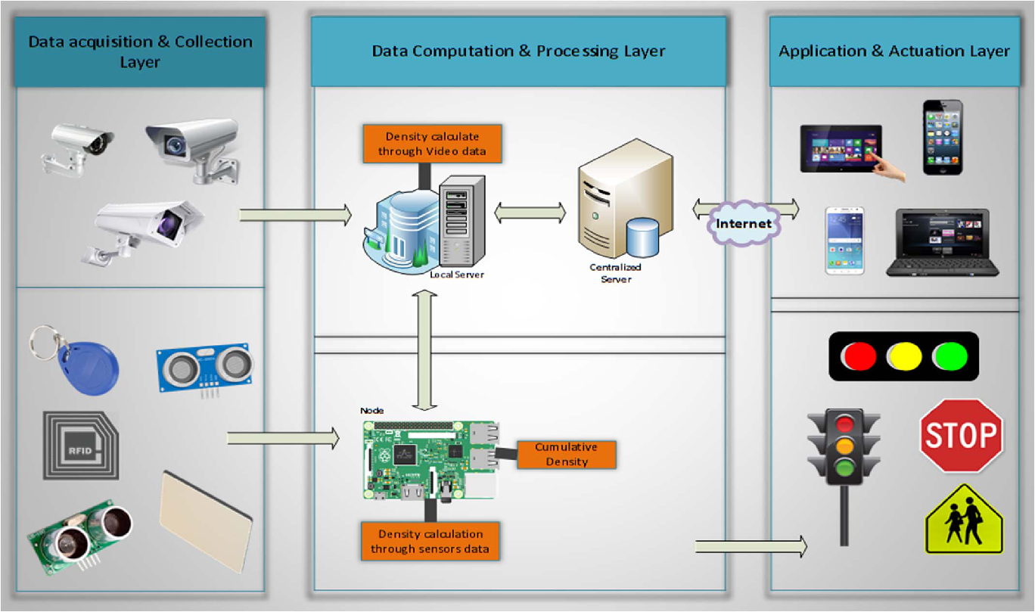
Methodology

Slide 8
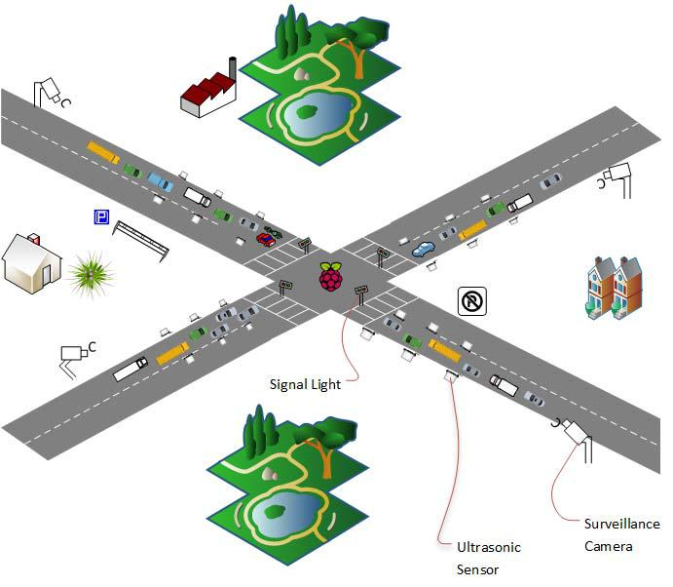
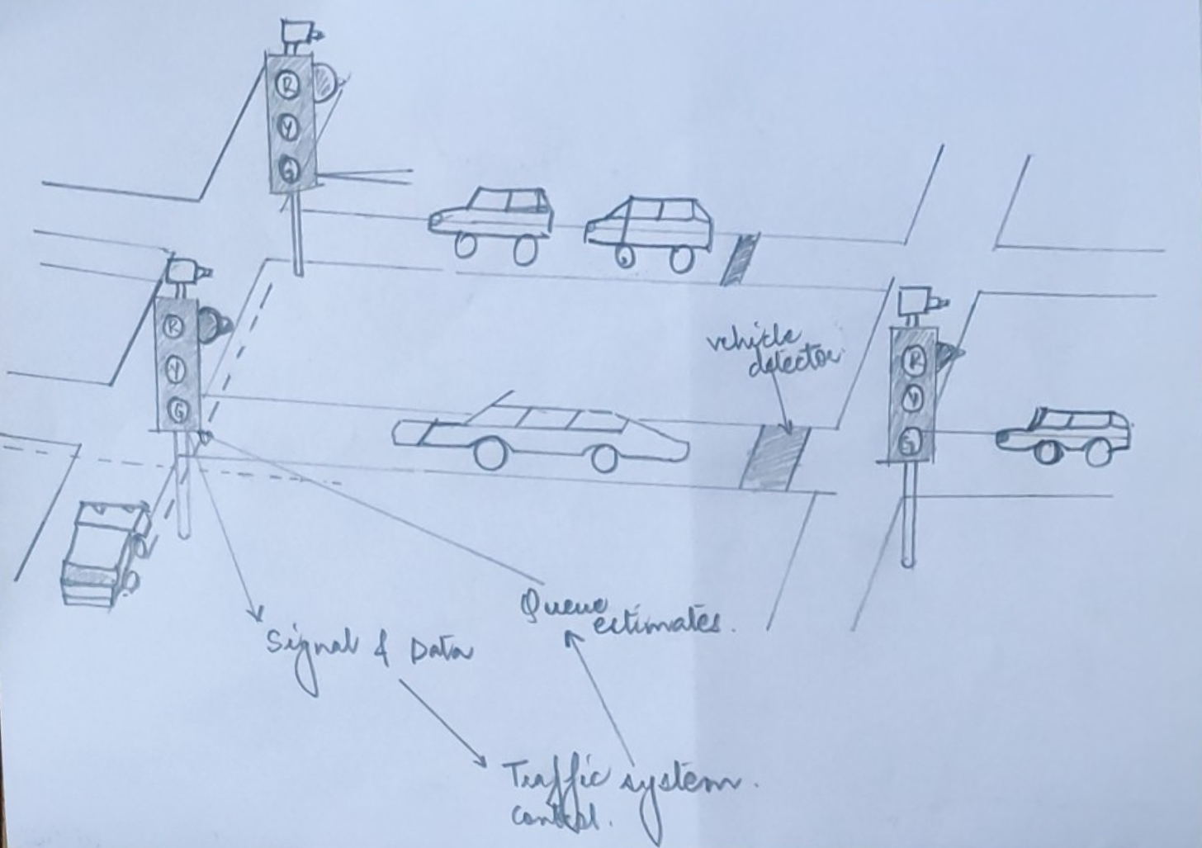
Overview of the Project:

Slide 9
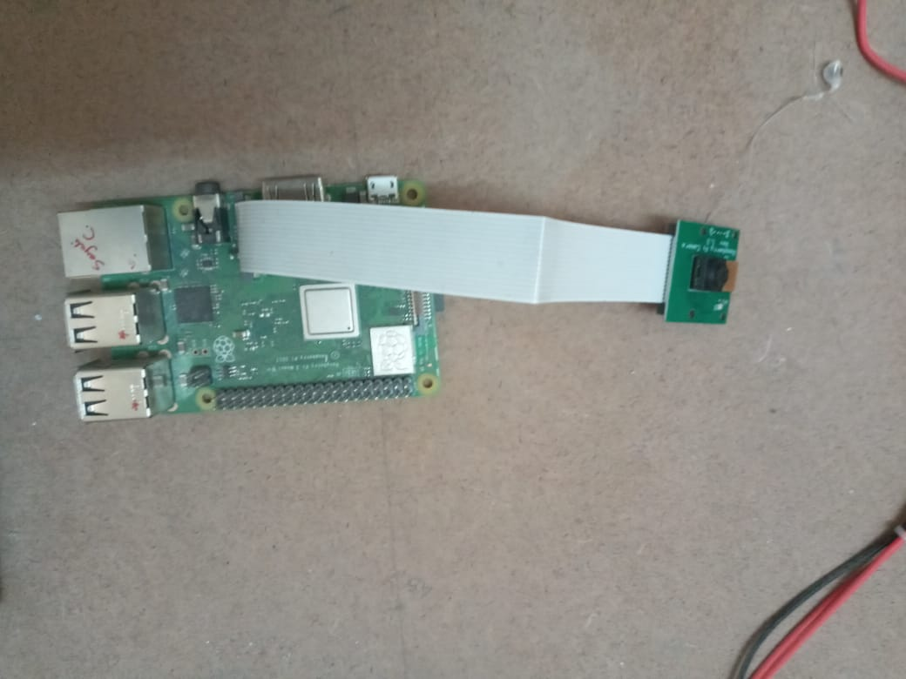
Pi Camera

Slide 10
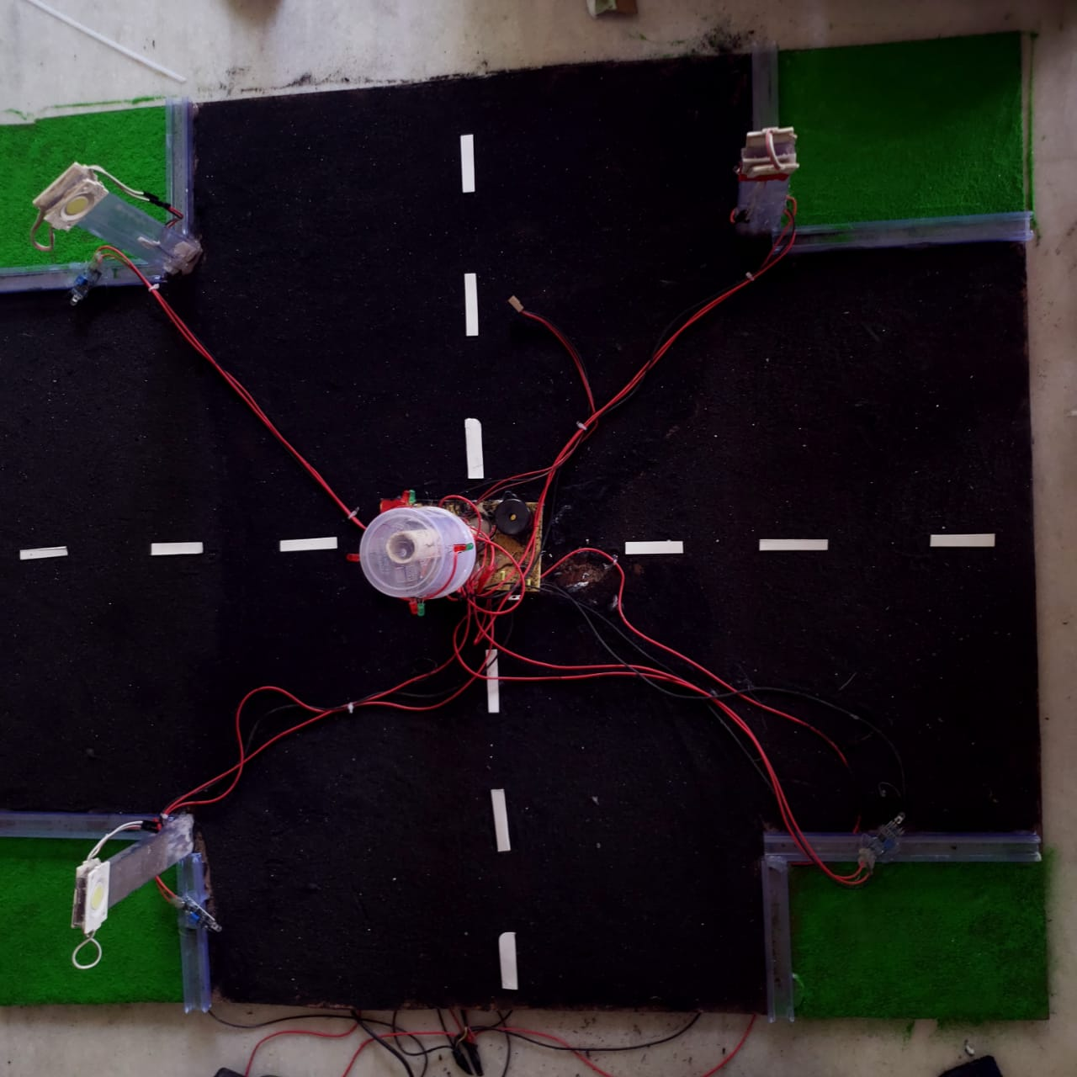
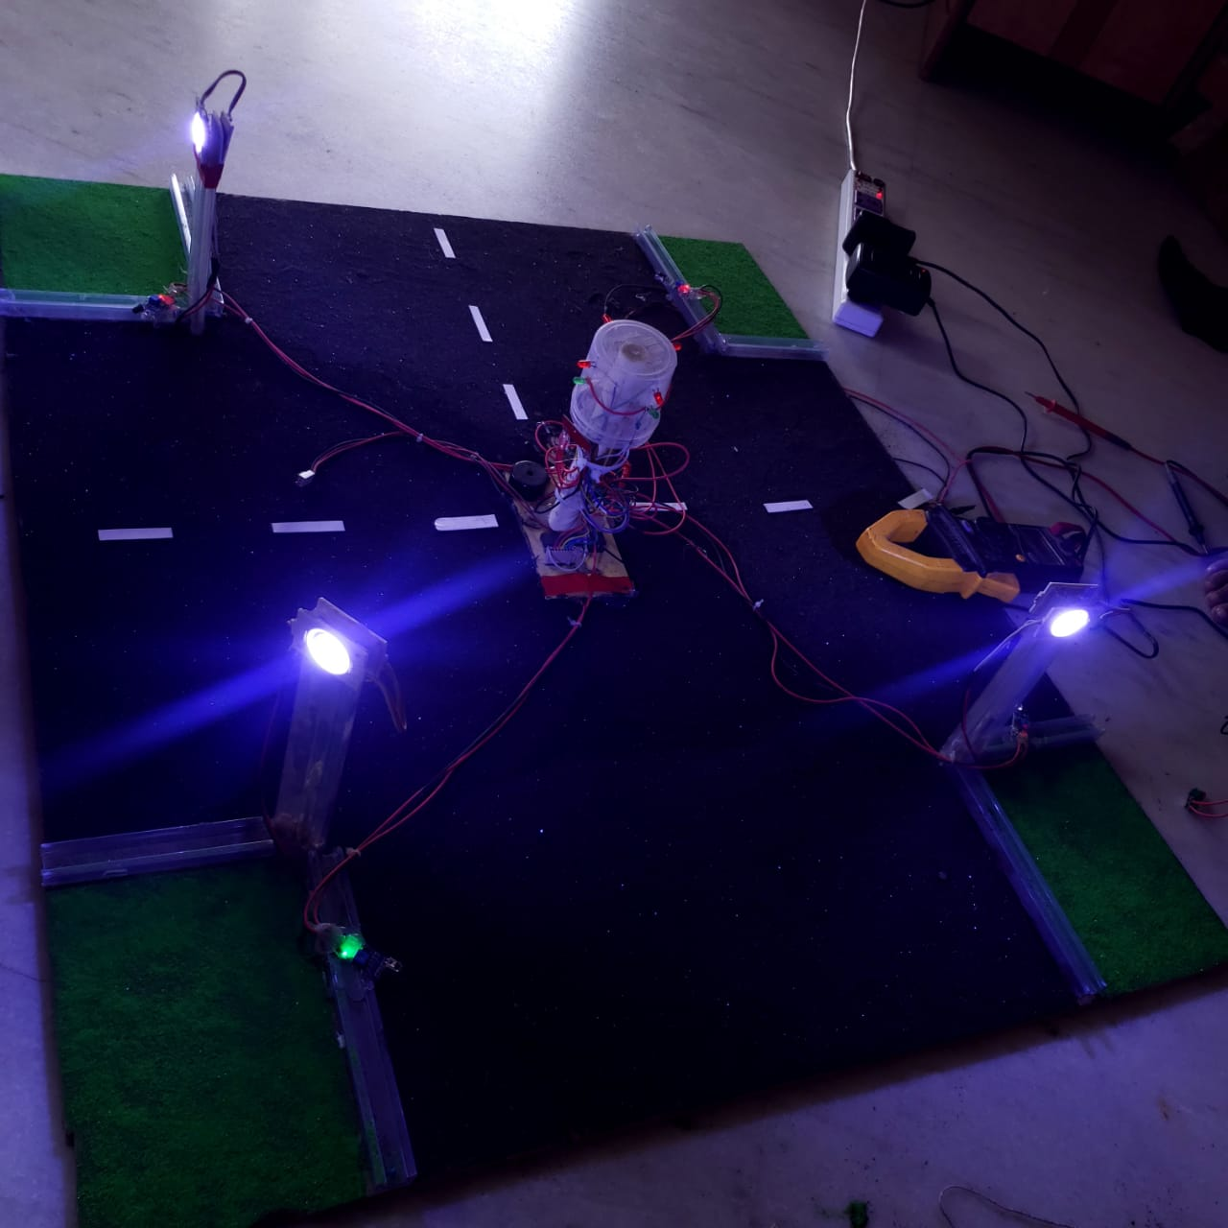

Slide 11
References
Smart Autonomous Traffic Light Switching by Traffic Density Measurement through Sensors, 2015.
"Smart and Scalable Urban Signal Networks". Retrieved 7 November 2017.
"The first smart traffic signal experiment in the world is a great success" (PDF). 30 July 2019.
Astarita, Vittorio (2019-11-28). "INTER TRAFFIC WORLD 2020". journal-download.co.uk. Retrieved 2019-11-28.
Astarita, Vittorio; Giofré, Vincenzo Pasquale; Festa, Demetrio Carmine; Guido, Giuseppe; Vitale, Alessandro (January 7, 2020). "Floating Car Data Adaptive Traffic Signals: A Description of the First Real-Time Experiment with "Connected" Vehicles". Electronics. 9 (1): 114. doi:10.3390/electronics9010114.
Millward, David (May 19, 2011). "Smart traffic lights to stop speeders". The Telegraph

Slide 12
Thank-You!!

